Slide 1







Programming Languages Popularity
Bram Kruit
28-06-2023

Slide 2



OUTLINE
Executive Summary
Introduction
Methodology
Results
Visualization – Charts
Dashboard
Discussion
Findings & Implications
Conclusion
Appendix

Slide 3

EXECUTIVE SUMMARY
JavaScript, HTML and SQL are the most popular programming languages.
Python and Typescript are the biggest risers.
MySQL, Microsoft SQL Server and PostgreSQL are the most popular databases.
PostgreSQL, MongoDB and Redis are the biggest risers.
Gender Gap
93,5% male
6,5% female

Slide 4

INTRODUCTION
What are the top programming languages in demand?
What are the top database skills in demand?
What are the popular IDEs?
Target audience
HR in tech companies.
Tech executives.

Slide 5

METHODOLOGY
Data sources used for analysis
Stack Overflow Developer Survey 2019.
GitHub Job Postings.
Programming Languages Annual Salary
Data exploration and Cleaning with Python.
Analysis and Visualization with IBM Cognos Analytics.
PowerPoint presentation to present the results.

Slide 6
RESULTS
Most popular programming languages and databases.
Outlook for next year.
Demographic statistics.

Slide 7
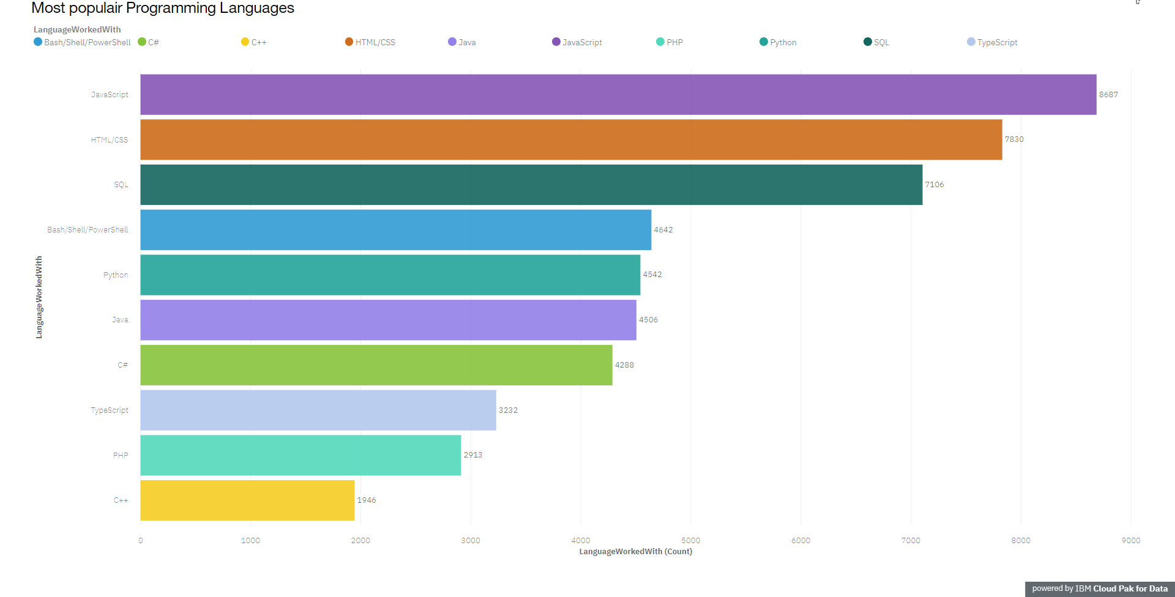
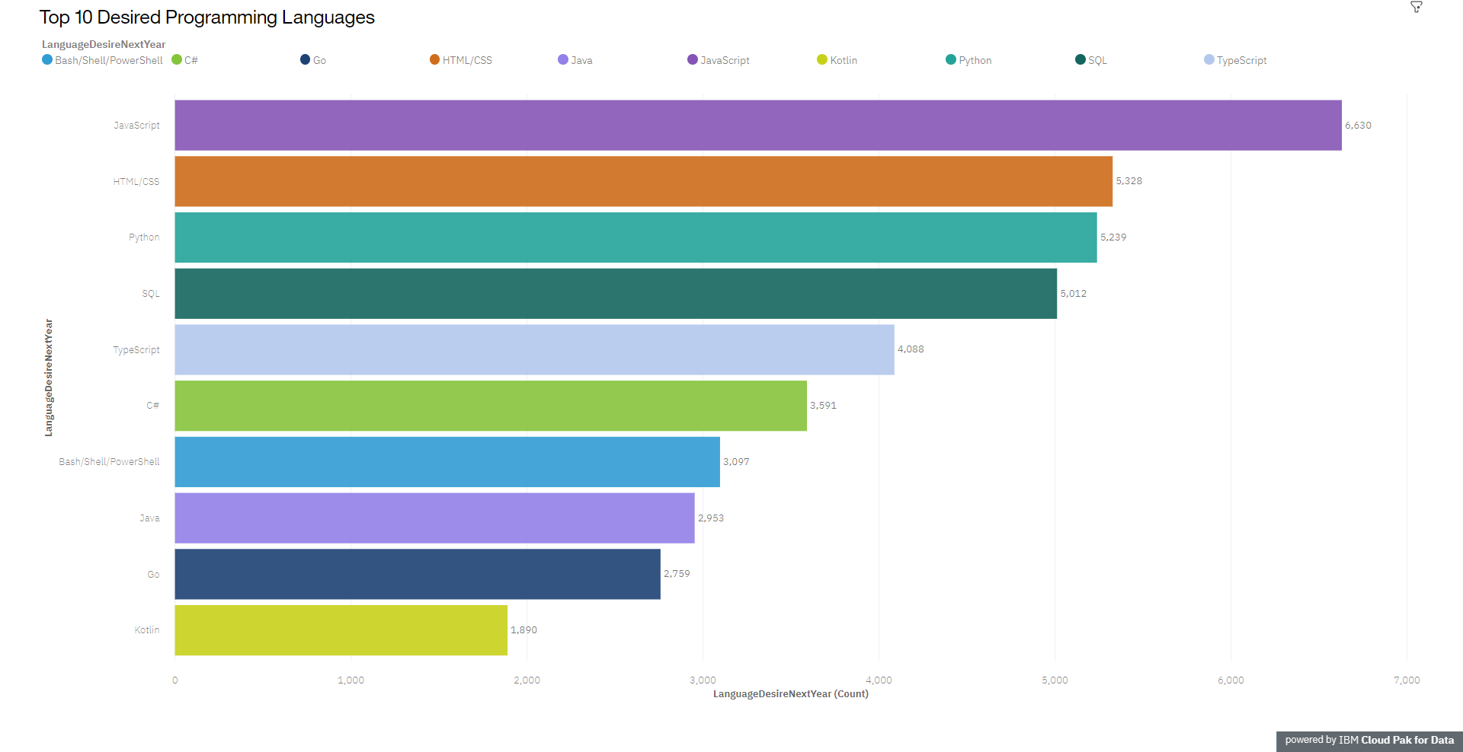
PROGRAMMING LANGUAGE TRENDS
Current Year
Next Year
<Bar chart of top 10 programming languages for the current year goes here.>
< Bar chart of top 10 programming languages for the next year goes here.>

Slide 8
PROGRAMMING LANGUAGE TRENDS - FINDINGS & IMPLICATIONS
Findings
JavaScript and HTML most popular in both graphs.
Python and TypeScript biggest risers.
PowerShell, Java and Go have the biggest drop.
Implications
The top languages show that Web Development is in high demand.
Growth in AI and Machine Learning make python the biggest riser.
The decline of PowerShell could be an indication of a decrease in Linux popularity.

Slide 9
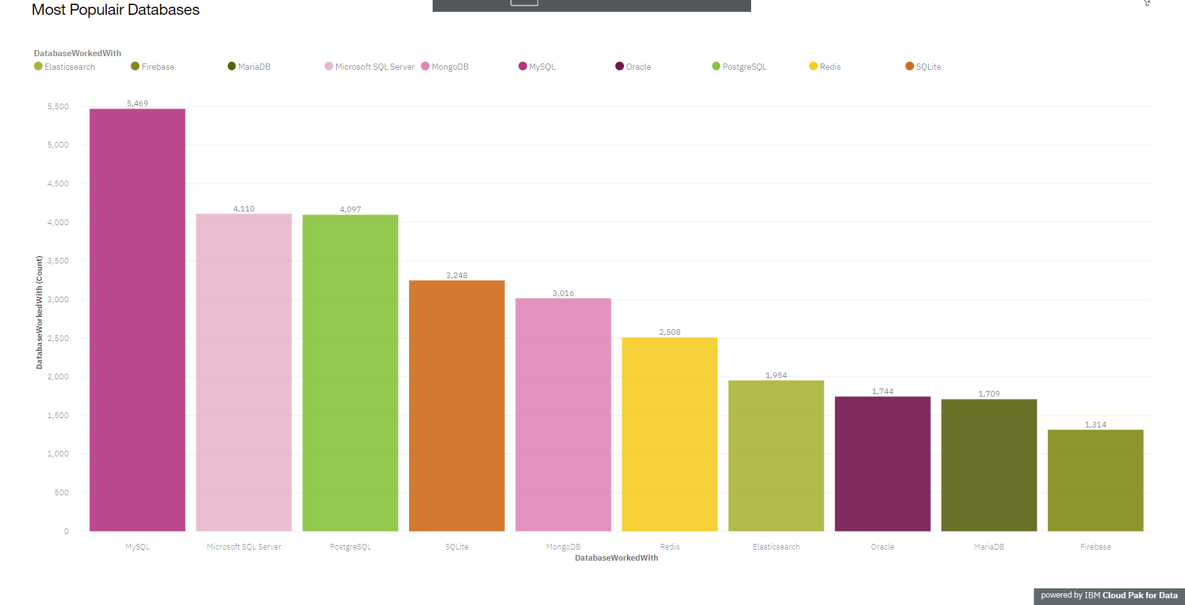
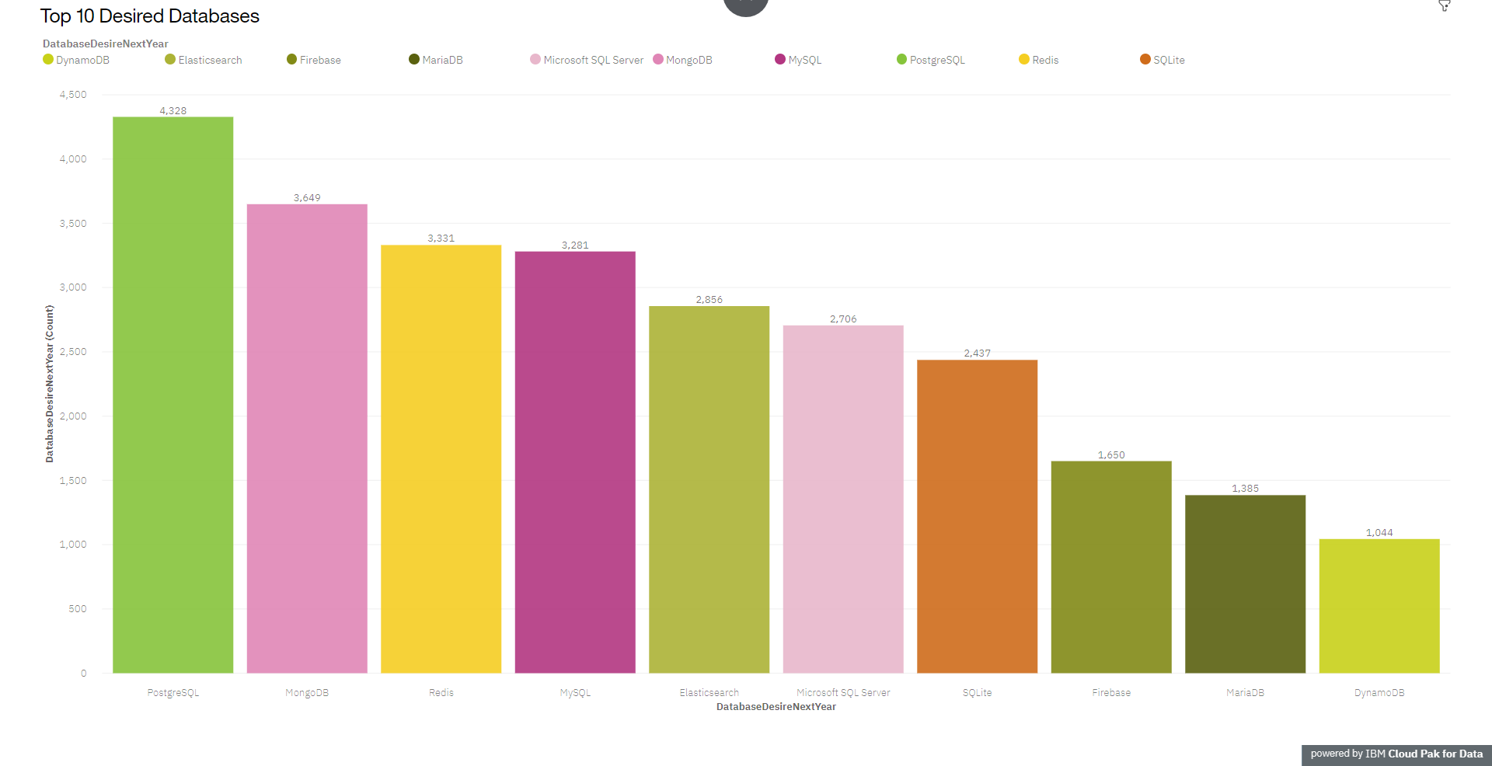
DATABASE TRENDS
Current Year
Next Year
< Bar chart of top 10 databases for the current year goes here >
< Bar chart of top 10 databases for the next year goes here.>

Slide 10
DATABASE TRENDS - FINDINGS & IMPLICATIONS
Findings
Big shift in popularity between the two graphs.
Big drops for MySQL and Microsoft SQL Server
MongoDB, Redis and PostgreSQL biggest risers.
Implications
Open Source databases are most popular.
Non-relational databases are becoming more popular.
Database demands are changing fast.

Slide 11

DASHBOARD
Link to full Dashboard

Slide 12
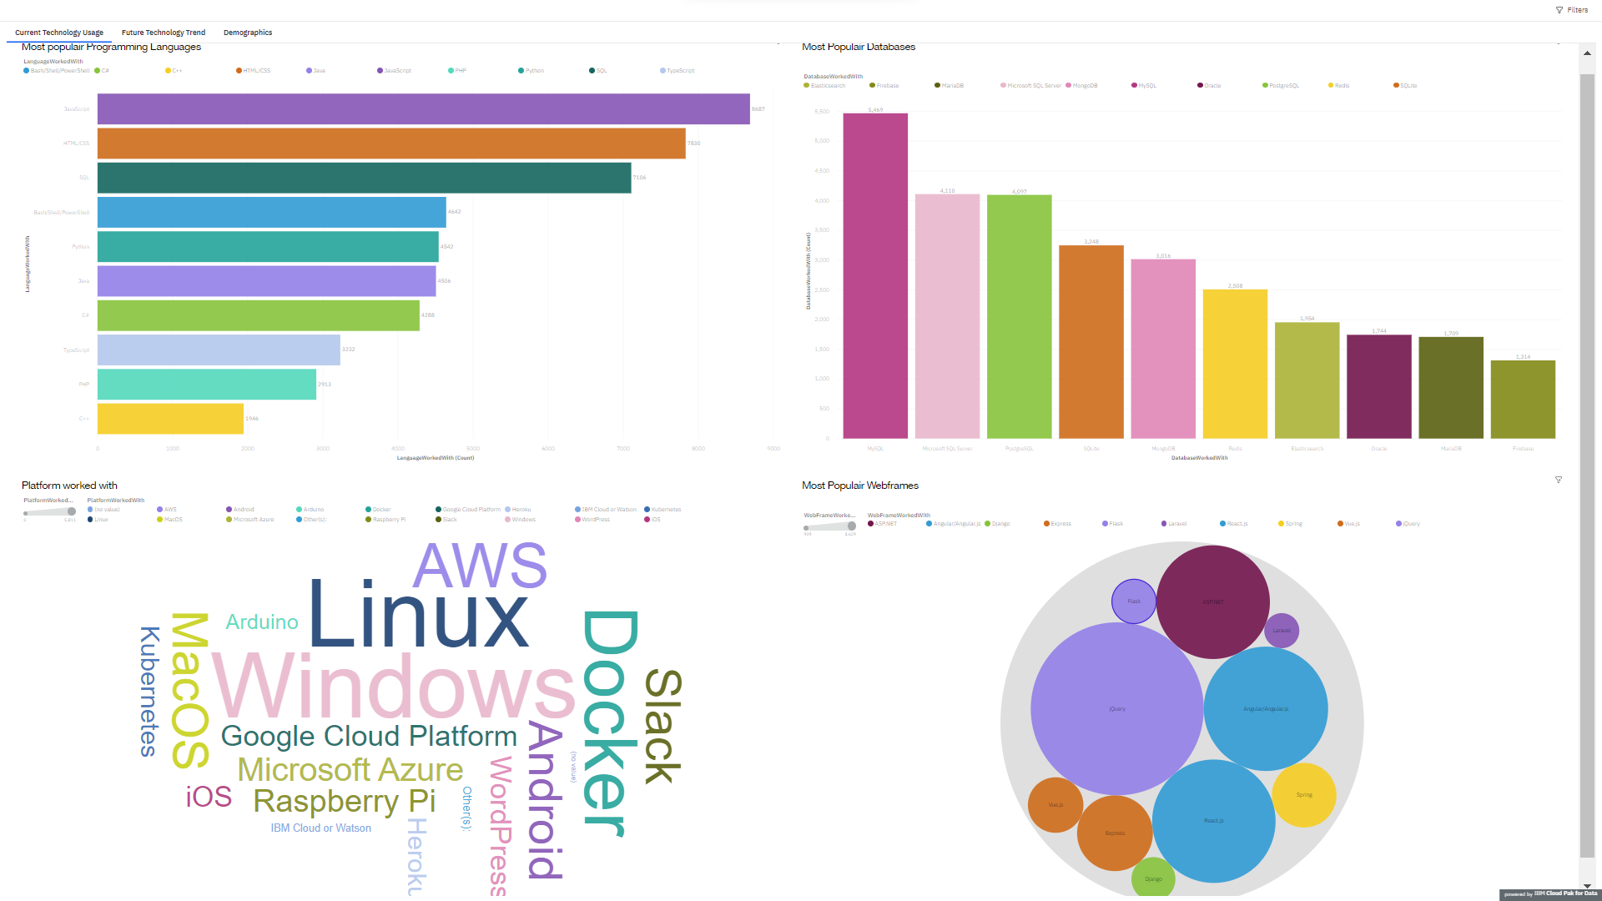
DASHBOARD TAB 1
Screenshot of dashboard tab 1 goes here

Slide 13
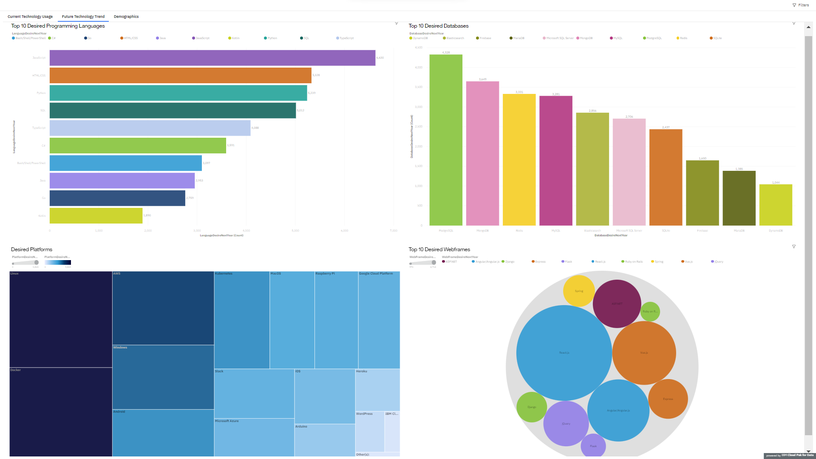
DASHBOARD TAB 2
Screenshot of dashboard tab 2 goes here

Slide 14
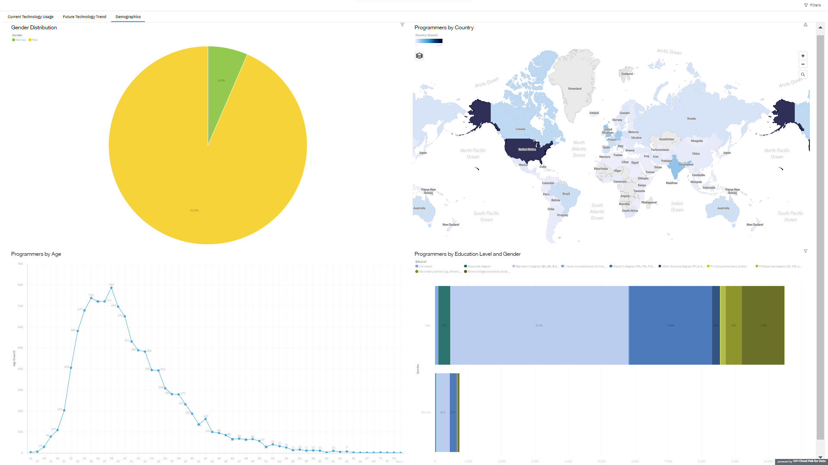
DASHBOARD TAB 3
Screenshot of dashboard tab 3 goes here

Slide 15
DISCUSSION
Make efforts to decrease gender gap.
Make programming a suitable career choice for people over 35.

Slide 16
OVERALL FINDINGS & IMPLICATIONS
Findings
Demands in technology are always changing.
Demographic data shows a large group of young male programmers.
Rise in popularity for non relational databases and AI technology.
Implications
Retraining and adding skills is vital to a companies success.
Focus on recruiting females and employees over 35.
Non relational databases and Python are rising skills in the future.

Slide 17

CONCLUSION
Web and AI development are key programming skills.
Database skills are changing fast.
More diversity in technology

Slide 18

APPENDIX
Job postings.
Programming languages by average yearly salary.

Slide 19
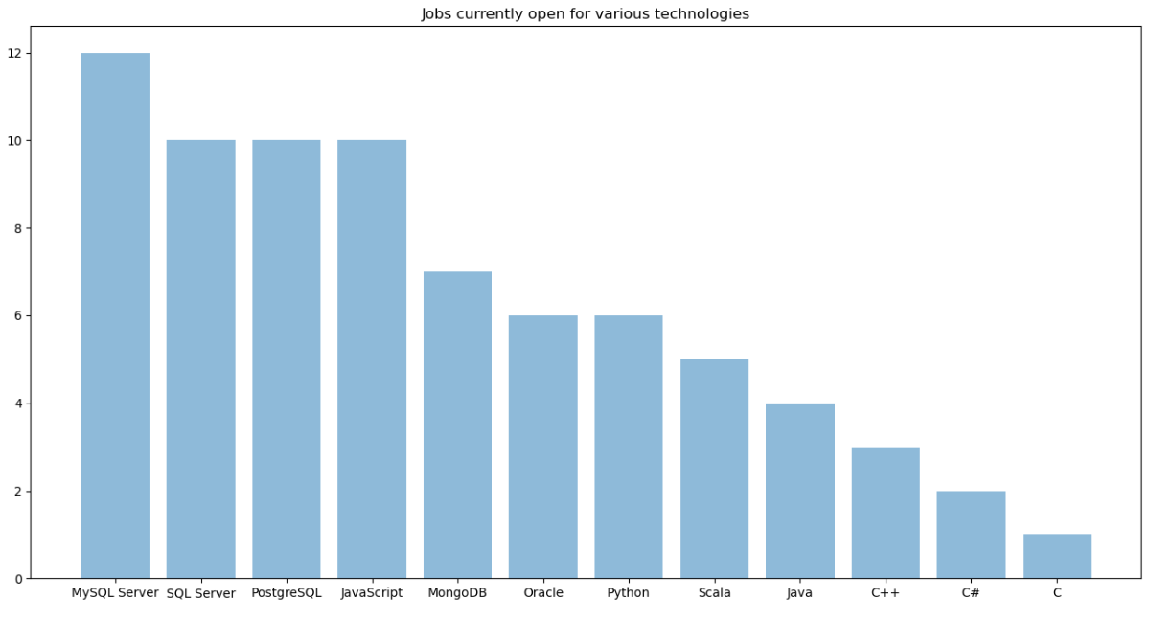
JOB POSTINGS

Slide 20
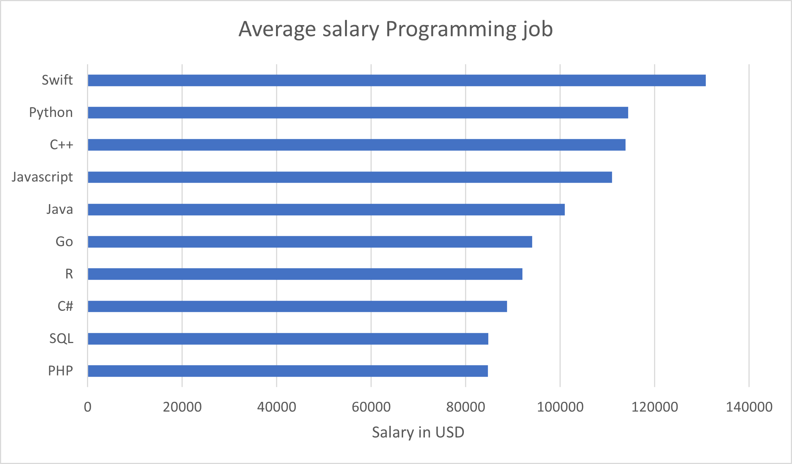
POPULAR LANGUAGES

